Slide 1

Running Deep Learning Applications on HPC System
Hao Ji, Data Scientist
USC Center for Advanced Research Computing

Slide 2
Introduction
ML Perf
PyTorch
Running DL Models
Content
Introduction
Section 1: History of AI
Section 2: ML Perf Benchmark
ML Perf
Conda
Section 3: Install PyTorch on Cluster
Running DL Models
Section 4: Running Deep Learning Models

Slide 3
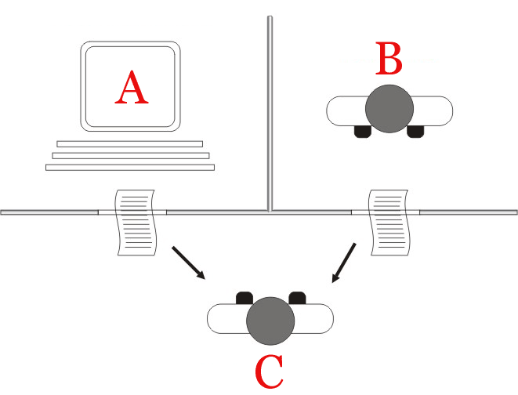
Introduction
ML Perf
PyTorch
Running DL Models
History of AI
Pre-1950s: Foundations of AI
The formal study of AI began with mathematicians and philosophers like Alan Turing.
In 1950, Alan Turing proposed the famous "Turing Test," a measure of a machine's ability to exhibit human-like intelligence. This concept laid the groundwork for future AI research.
The "standard interpretation" of the Turing test, in which player C, the interrogator, is given the task of trying to determine which player – A or B – is a computer and which is a human. The interrogator is limited to using the responses to written questions to make the determination.

Slide 4
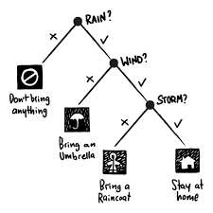
Introduction
ML Perf
PyTorch
Running DL Models
History of AI
1950s and 1960s: Early Research and Symbolic AI
The term "artificial intelligence" was coined in 1956 at the Dartmouth Conference, where the field of AI research was officially established.
During this period, researchers focused on symbolic AI, using rules and logic to mimic human problem-solving processes.

Slide 5
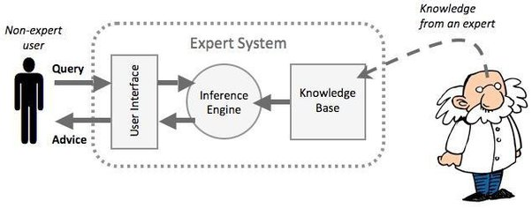
Introduction
ML Perf
PyTorch
Running DL Models
History of AI
1970s and 1980s: Knowledge-Based Systems AI
Research saw a shift towards knowledge-based systems and expert systems.
These systems utilized large knowledge bases to reason and draw conclusions about specific domains.
Though promising, early expert systems faced limitations due to the complexity of representing all human knowledge in a formalized manner.

Slide 6

Introduction
ML Perf
PyTorch
Running DL Models
History of AI
1980s and 1990s: AI Winter
During this period, AI faced a decline in interest and funding due to unmet expectations and the inability to deliver on grand promises.
Progress in AI did not match initial optimism, leading to a phase known as the "AI Winter."

Slide 7
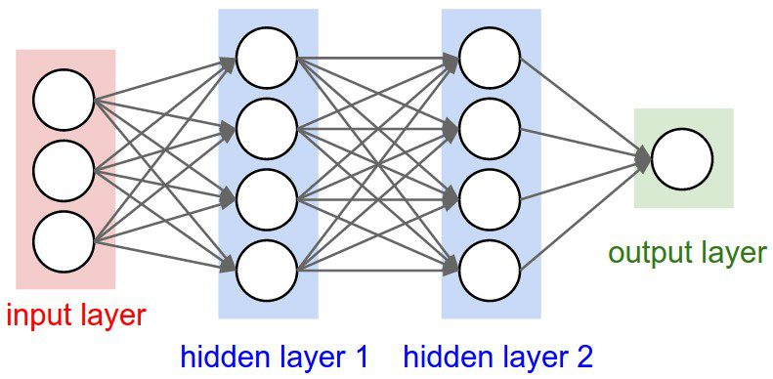
Introduction
ML Perf
PyTorch
Running DL Models
History of AI
Late 1990s and 2000s: Machine Learning and Neural Networks
The resurgence of AI came with the advent of machine learning techniques, particularly neural networks.
Improved computational power and access to vast amounts of data allowed neural networks to excel in tasks like image recognition and language processing.
Support vector machines and other machine learning algorithms also gained popularity.

Slide 8
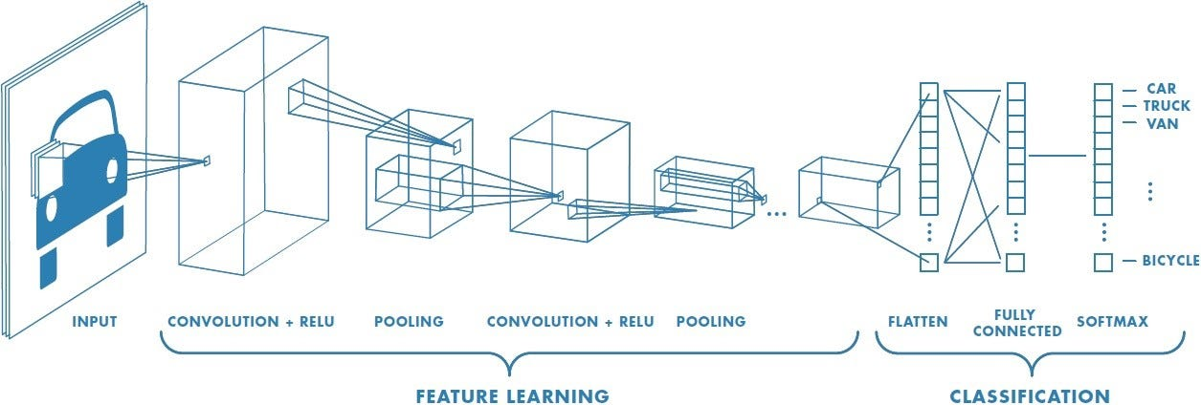
Introduction
ML Perf
PyTorch
Running DL Models
History of AI
2010s: Deep Learning and AI Breakthroughs
Deep learning, a subset of machine learning using artificial neural networks with multiple layers, became the driving force behind many AI breakthroughs.
Applications of AI proliferated in various fields, including natural language processing, computer vision, robotics, and autonomous vehicles.

Slide 9
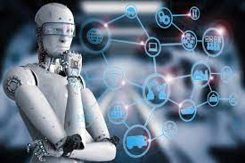
Introduction
ML Perf
PyTorch
Running DL Models
History of AI
Present and Beyond
AI continues to evolve rapidly, with ongoing research in areas like reinforcement learning, explainable AI, Large Language Model and AI ethics.
Integration of AI in everyday life through virtual assistants, smart devices, and recommendation systems is becoming increasingly common.
However, concerns about AI's societal impact, privacy, and ethical implications persist.

Slide 10
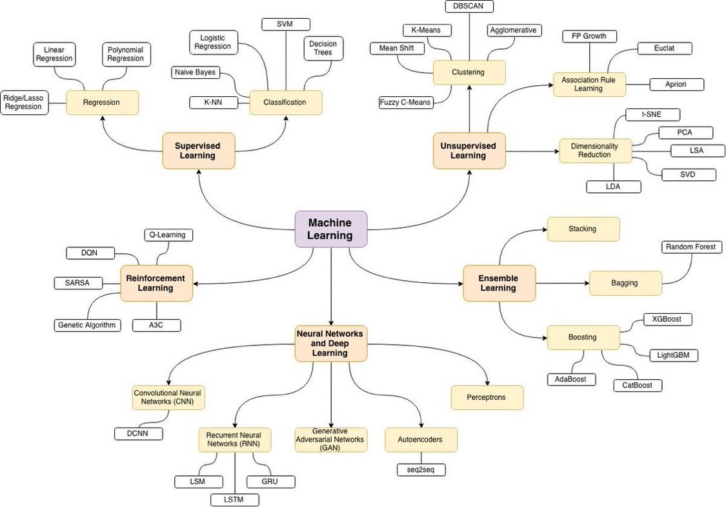
Introduction
ML Perf
PyTorch
Running DL Models
Introduction of Machine Learning

Slide 11
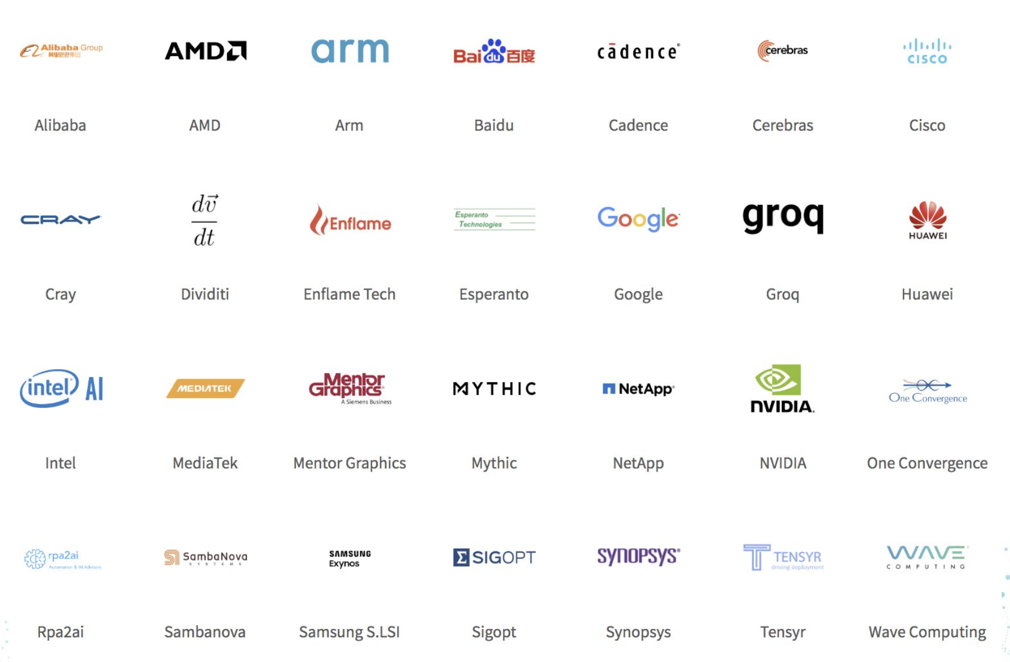
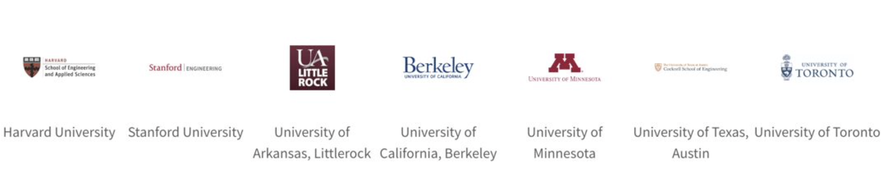
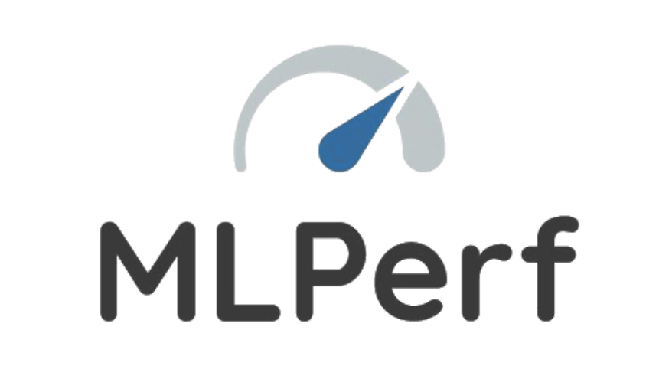
Introduction
ML Perf
PyTorch
Running DL Models
ML Perf Benchmark
ML Perf: A broad ML benchmark suite for measuring the performance of ML software frameworks, ML hardware accelerators, and ML cloud and edge platforms

Slide 12
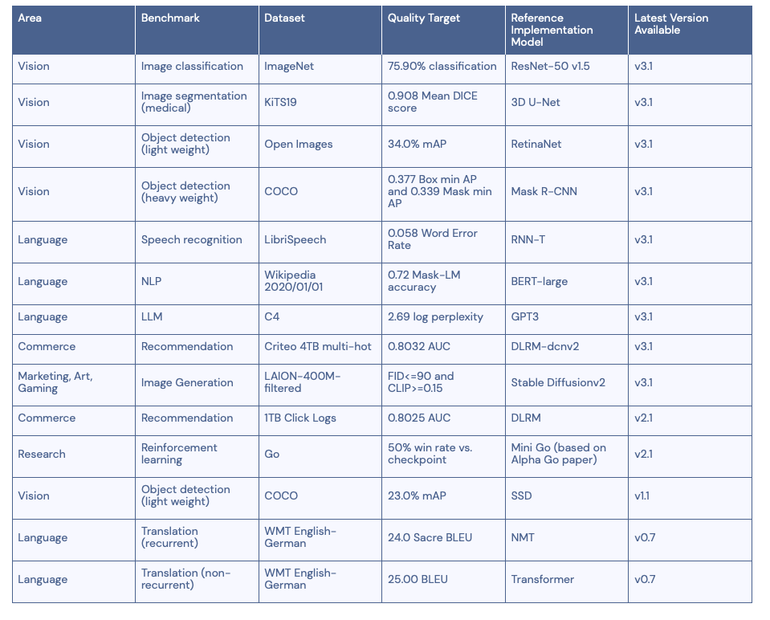
Introduction
ML Perf
PyTorch
Running DL Models
ML Perf Benchmark

Slide 13
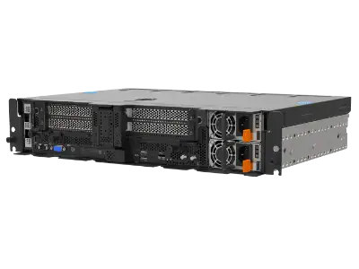

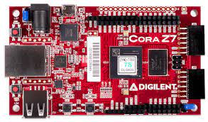
Introduction
ML Perf
PyTorch
Running DL Models
ML Perf Benchmark
ML Perf Training
ML Perf Inference
ML Perf Storage
The MLPerf Training benchmark measures how fast systems can train models to a target quality metric.
The MLPerf inference benchmark suite measures how fast systems can process inputs and produce results using a trained model
The MLPerf Storage benchmark suite measures how fast storage systems can supply training data when a model is being trained.
MLPerf Training
MLPerf Training: HPC
MLPerf Inference: Datacenter
MLPerf Inference: Edge
MLPerf Inference: Mobile
MLPerf Inference: Tiny
MLPerf Storage
Edge: Lenovo SE450 Edge Server
Mobile: Xiaomi note12 turbo
Tiny: Cora Z7 for ARM/FPGA SoC Development
Notes:
SOC: System on a Chip

Slide 14
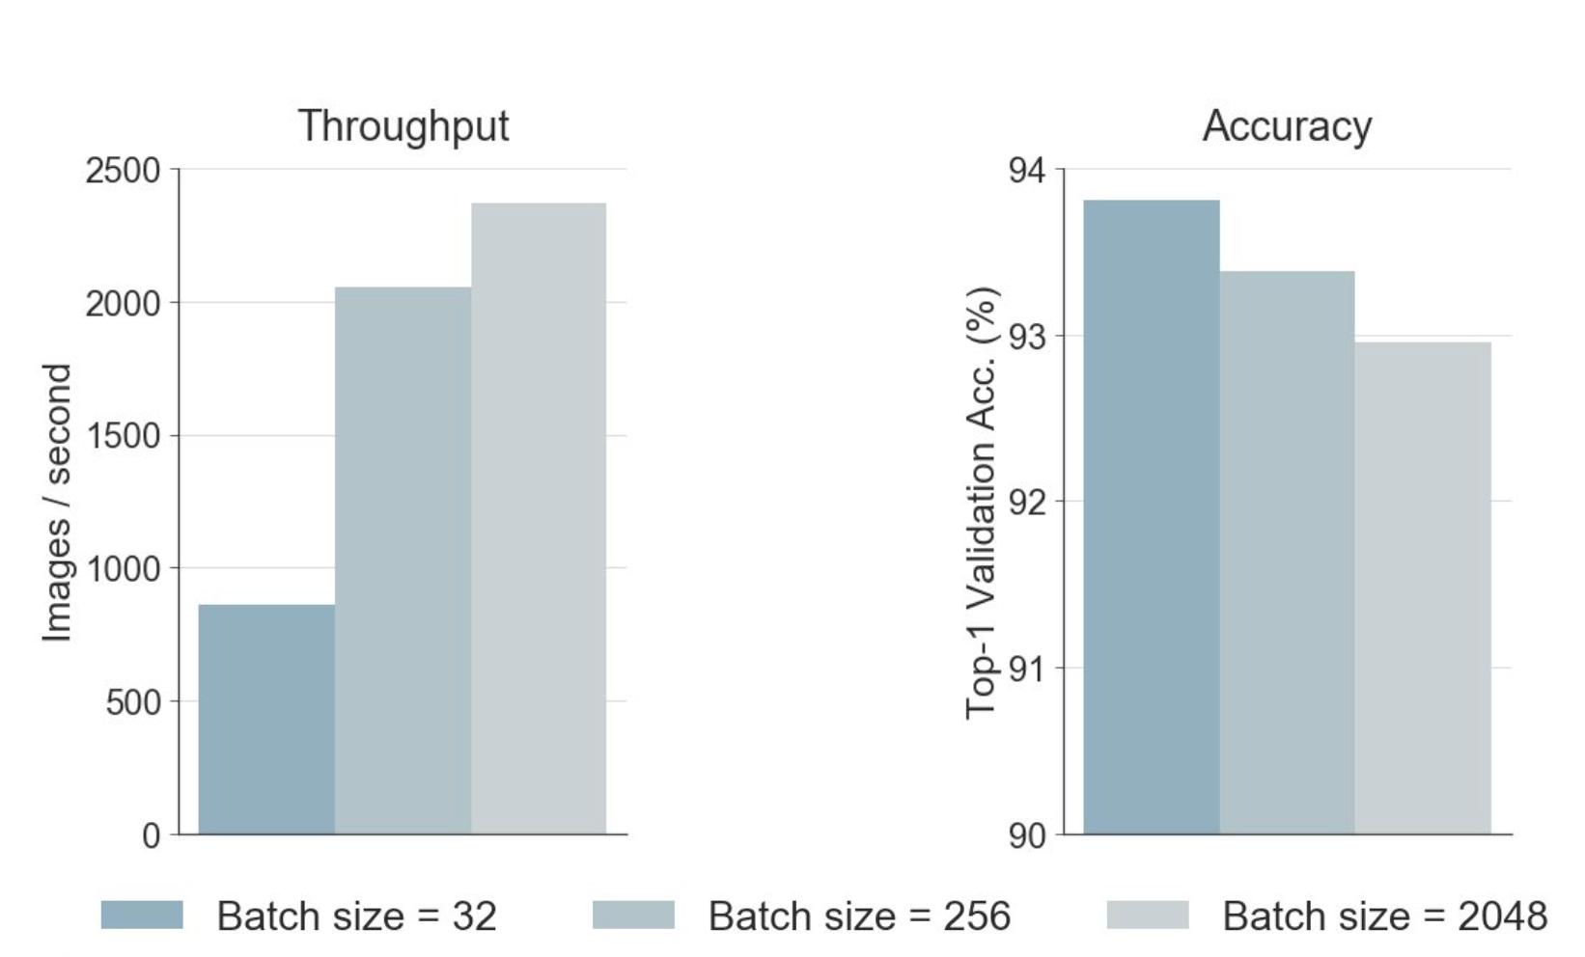
Introduction
ML Perf
PyTorch
Running DL Models
ML Perf Training Benchmark
Performance
How fast is a model for training, inference?
Quality
End to end training of a Resnet56 CIFAR10 model
Nvdia P100 with 512GB of memory and 28 CPU cores
TensorFlow 1.2 compiled from source with CUDA 8.0 and CuDNN 5.1
How good are a model’s predictions?

Slide 15
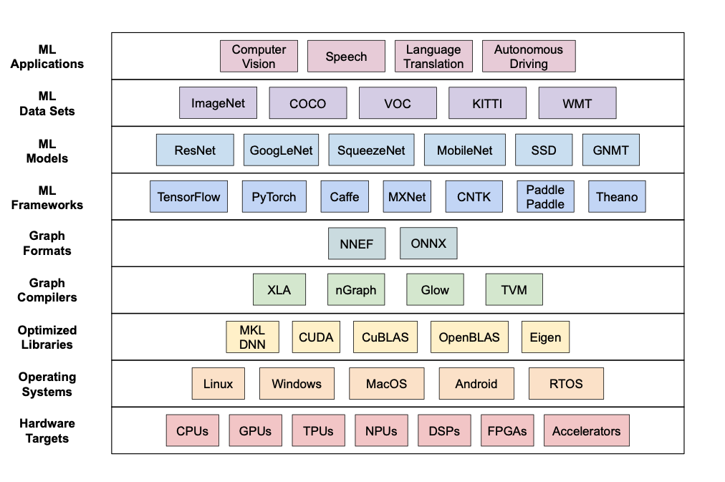
Introduction
ML Perf
PyTorch
Running DL Models
ML Perf Benchmark

Slide 16
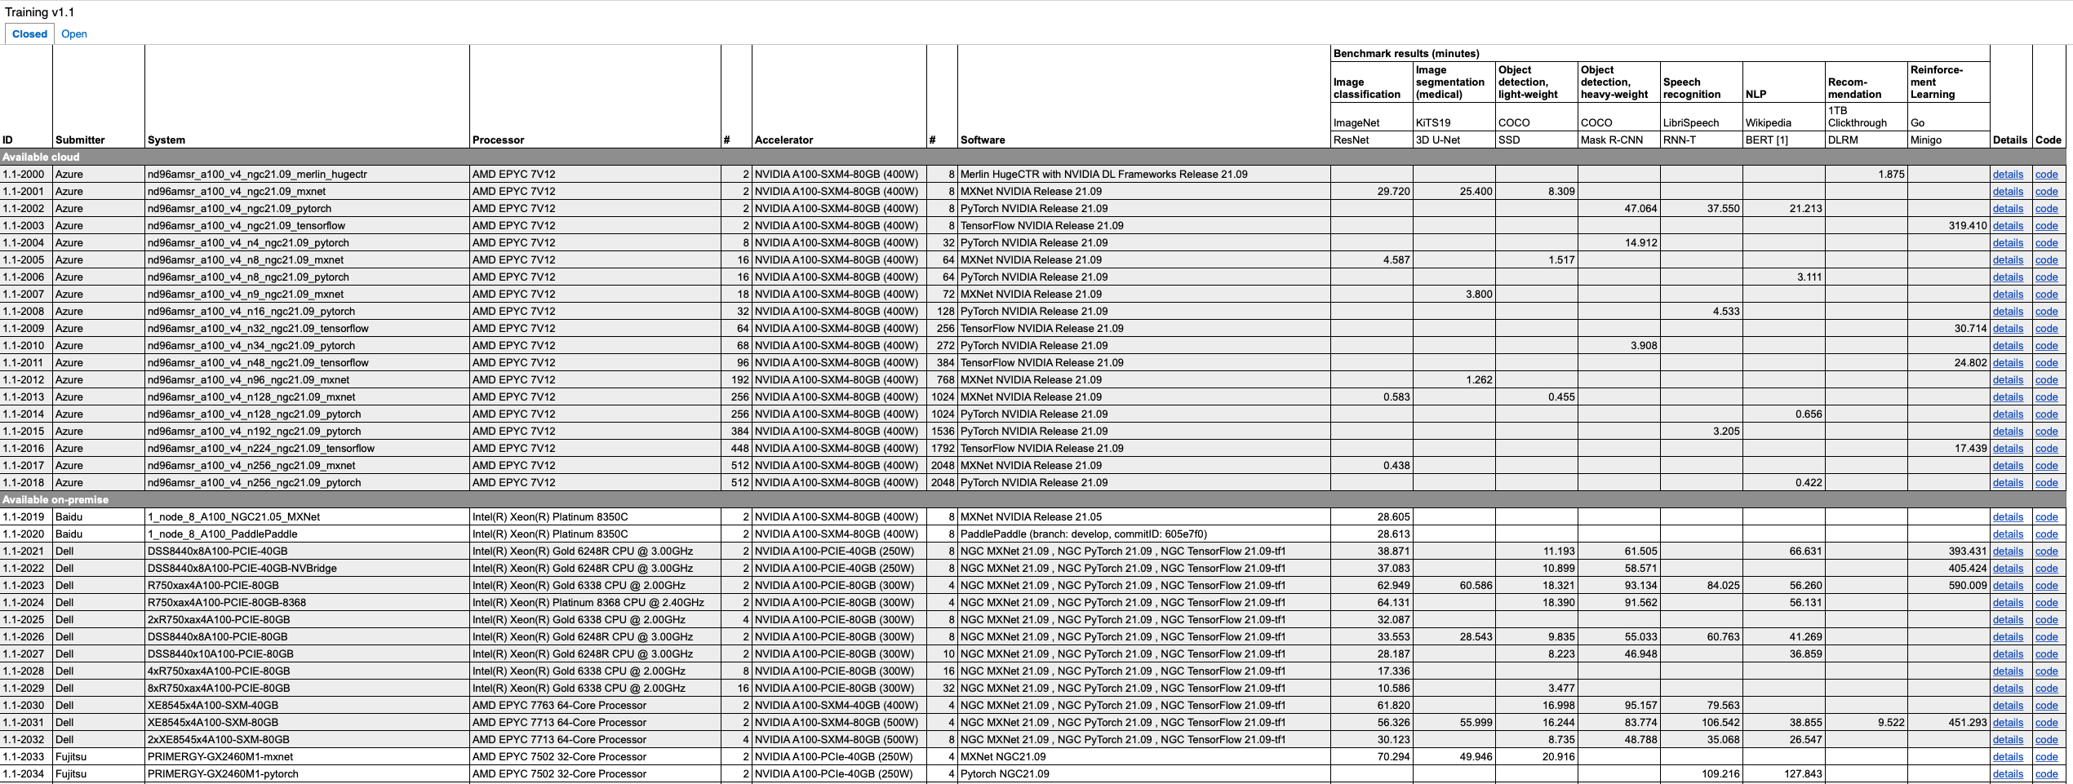
Introduction
ML Perf
PyTorch
Running DL Models
ML Perf Benchmark

Slide 17
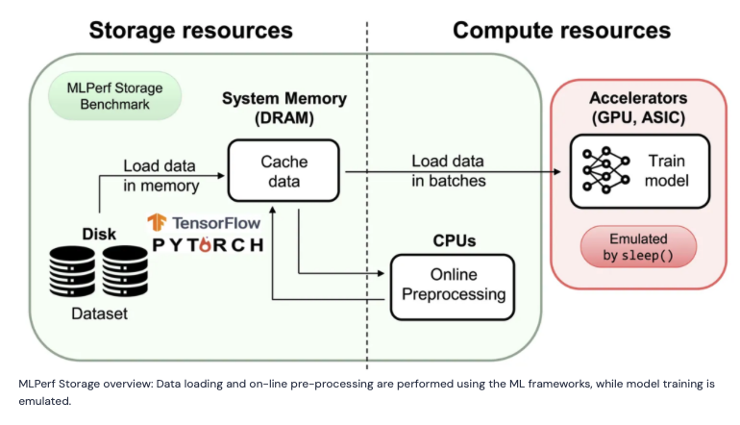
Introduction
ML Perf
PyTorch
Running DL Models
ML Perf Storage Benchmark
The MLPerf Storage benchmark suite measures how fast storage systems can supply training data when a model is being trained.

Slide 18
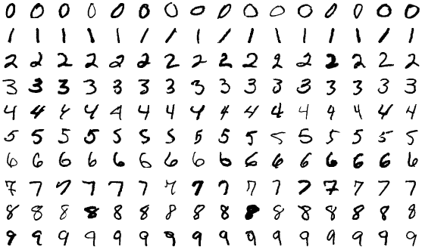
Introduction
ML Perf
PyTorch
Running DL Models
An example of Training
The problem we’re going to solve today is to train a model to classify MNIST datasets. The MNIST database of handwritten digits has a training set of 60,000 examples, and a test set of 10,000 examples.

Slide 19
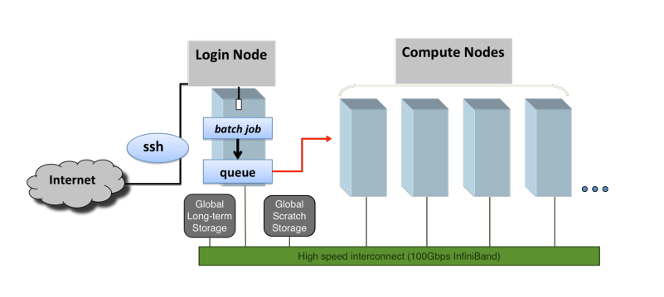
Introduction
ML Perf
PyTorch
Running DL Models
CARC Cluster

Slide 20
Introduction
ML Perf
PyTorch
Running DL Models
Slurm script for job submission
git clone https://github.com/uschpc/Running-DL-Applications.git

Slide 21
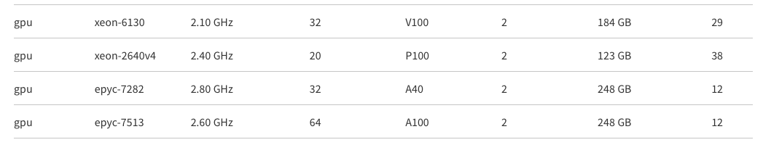
Introduction
ML Perf
PyTorch
Running DL Models
Common types of GPU

Slide 22
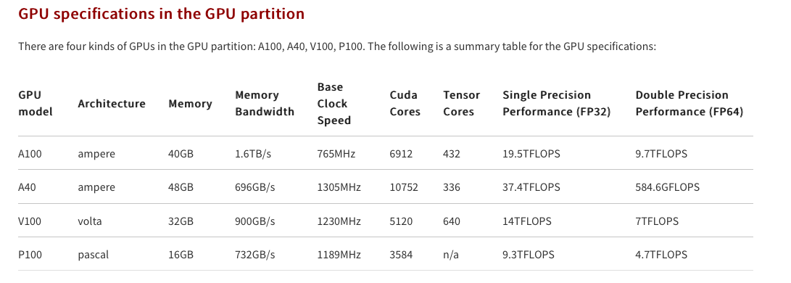
Introduction
ML Perf
PyTorch
Running DL Models
Common types of GPU

